Slide 1
Employee salary prediction
CAPSTONE PROJECT
Presented By:
Ajay Vishwakarma
College- Indian Institute of Technology Patna
Department- Computer Science

Slide 2
OUTLINE
Problem Statement
System Development Approach
Algorithm & Deployment (Step by Step Procedure)
Result
Conclusion
Future Scope
References

Slide 3
Problem Statement
Organizations want to analyze and predict whether an employee earns above or below a certain salary threshold (50k) based on attributes like age, education, and work experience.
Manual analysis is time-consuming, inefficient, and prone to error. There's a need to identify the key features influencing salary without bias or assumptions.

Slide 4
System Approach
Language: Python
Libraries: pandas, matplotlib, seaborn, scikit-learnIDE
Notebook: Jupyter Notebook
Dataset: Adult Income Dataset (renamed as employee.csv)
Models Used: Logistic Regression, Decision Tree, Random Forest, SVM, KNN

Slide 5
Algorithm & Deployment
Data Collection and Loading
Data Cleaning and Preprocessing
Exploratory Data Analysis (EDA)
Feature Encoding & Scaling
Model Training (multiple algorithms)
Model Evaluation
Model Selection and Export

Slide 6
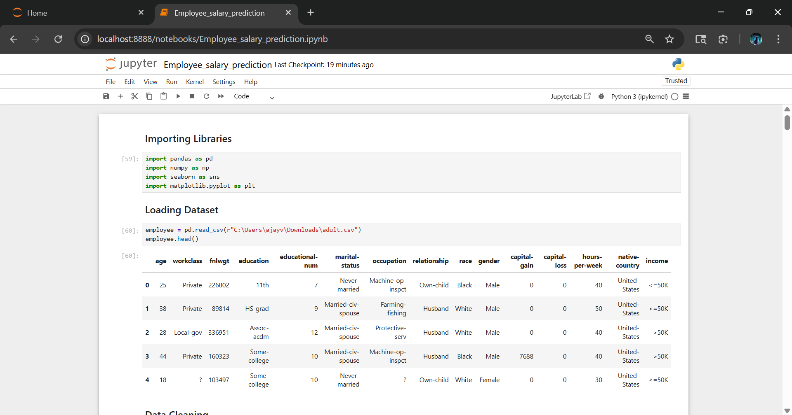
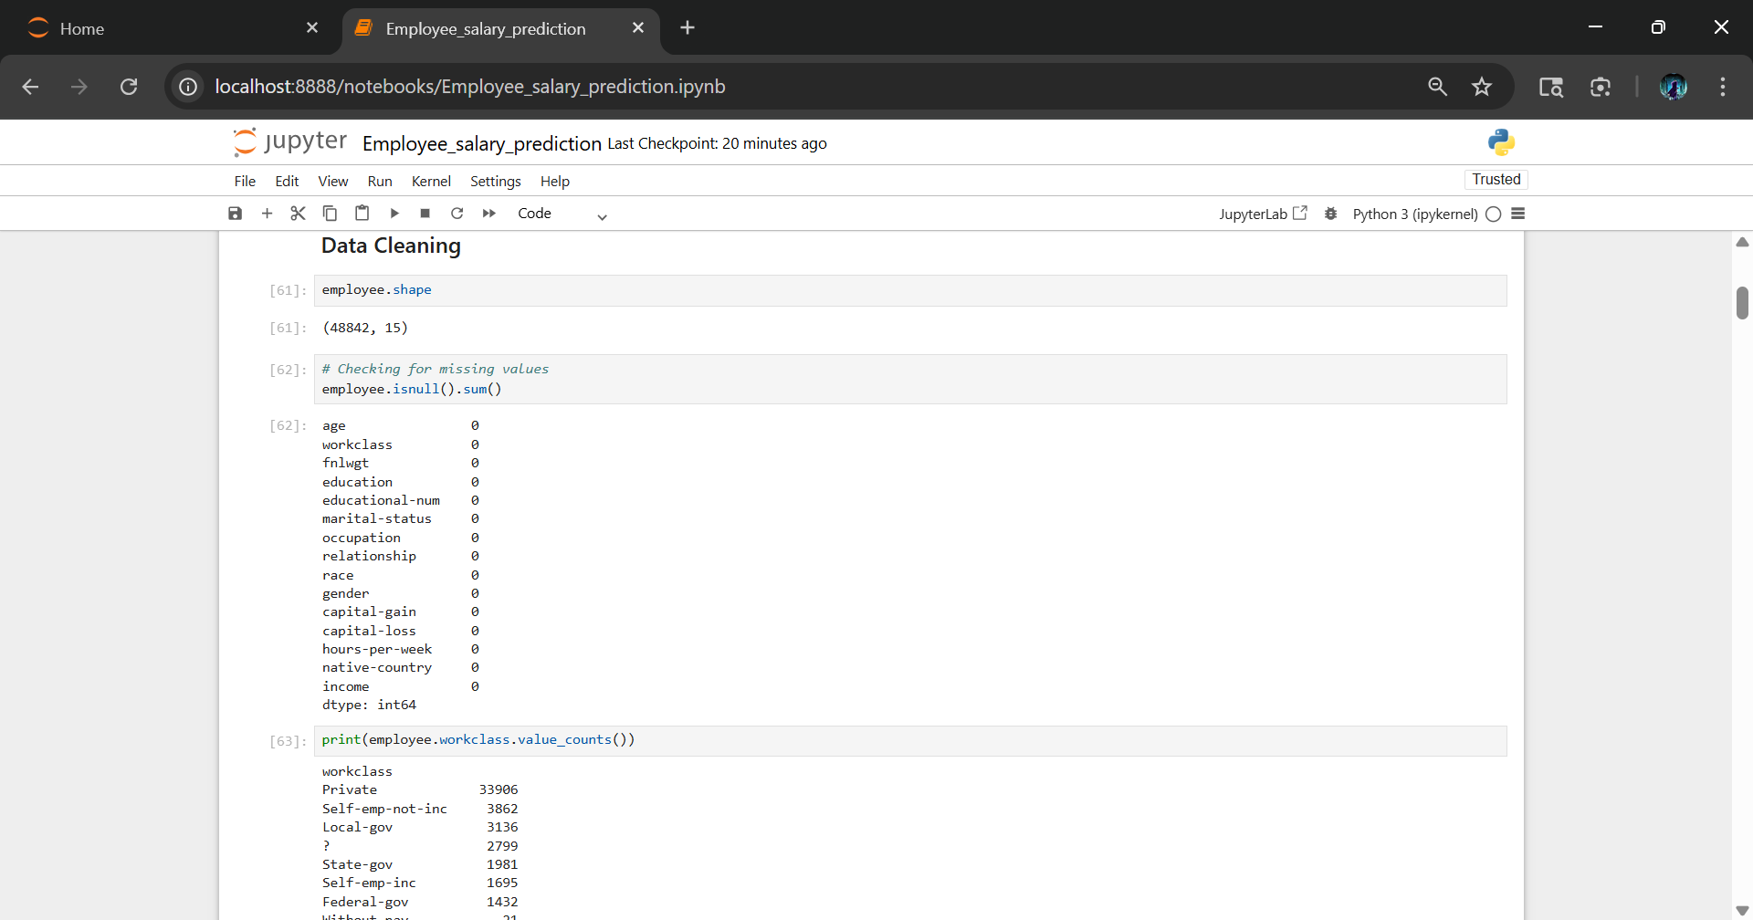
Result
GITHUB LINK: https://github.com/Ajayvish23/Employee-Salary-Prediction

Slide 7
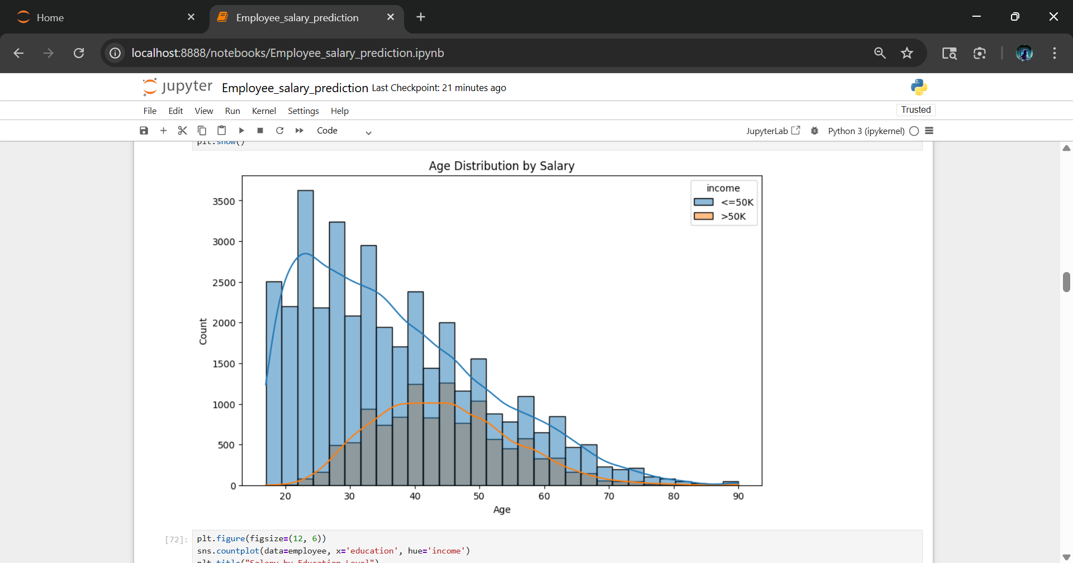
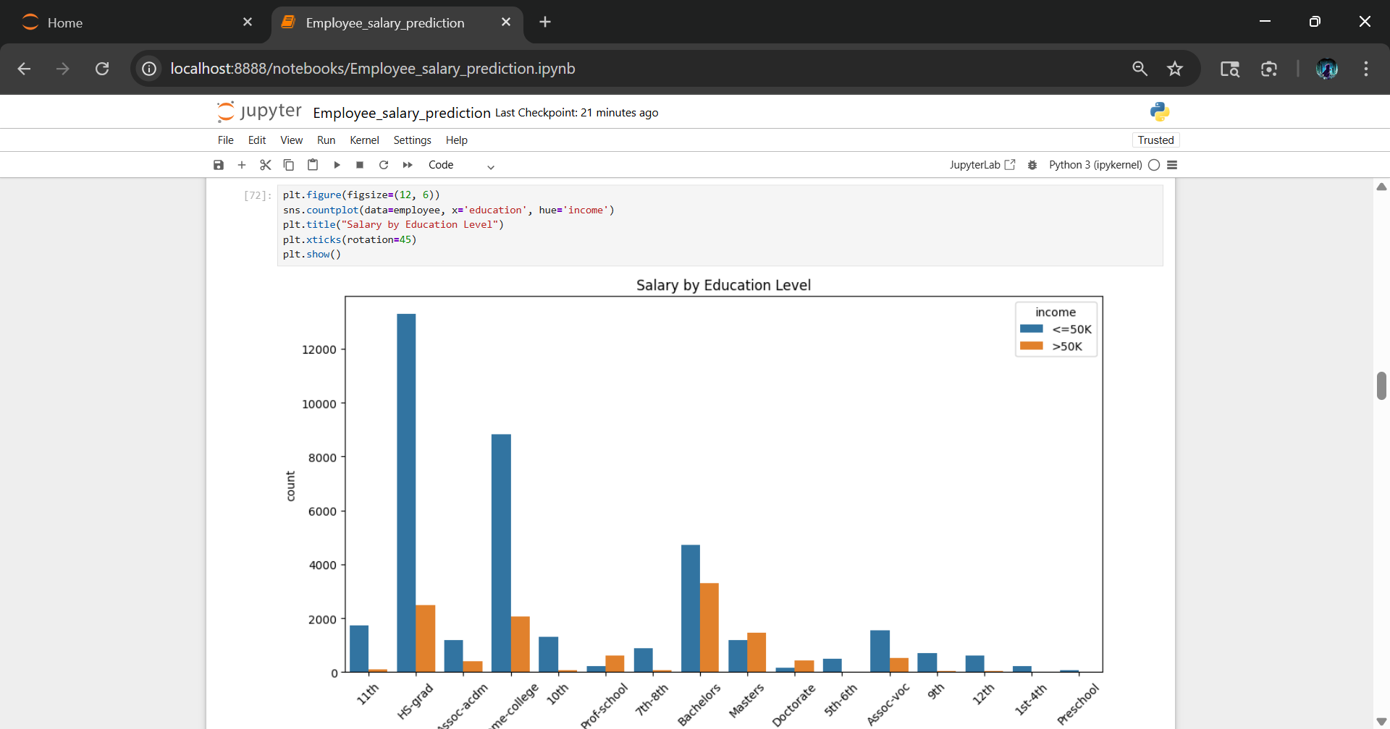
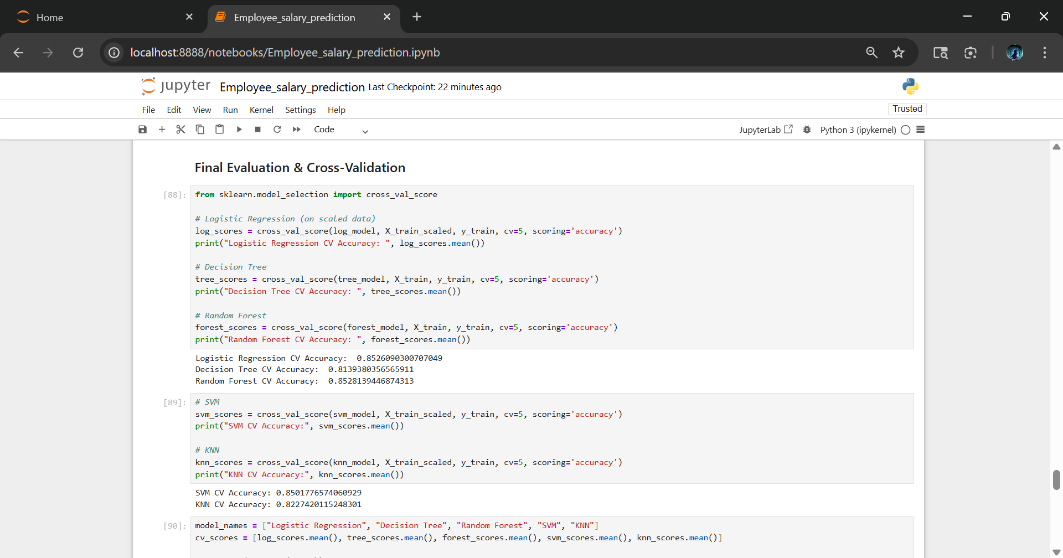
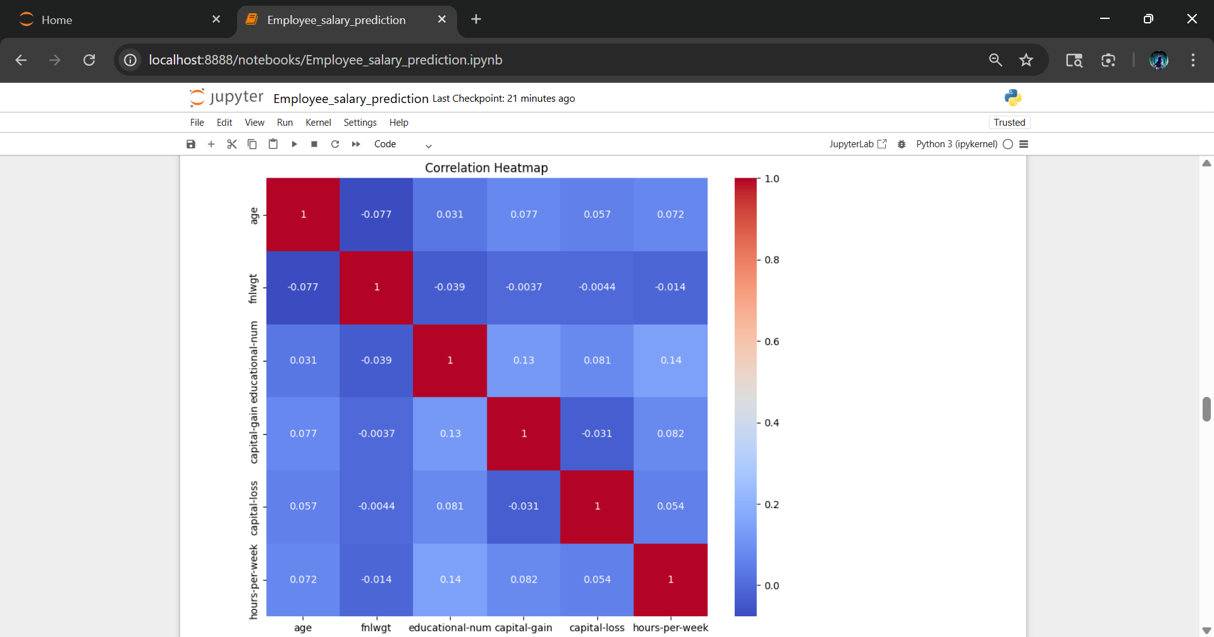

Slide 8
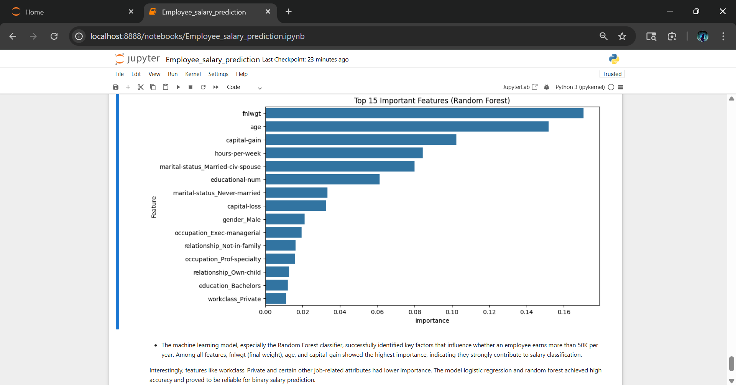
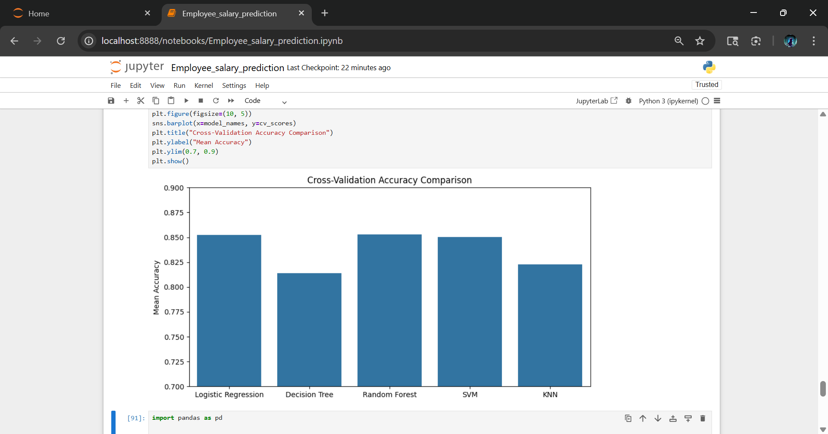

Slide 9
Final observation
About 11k people has salary greater than 50k. And 37k people has salary less than 50k.
40-50 years old people earn more than 50k.
Occupation like Executive manager and Prof. Speciality have large number of people with above 50k salary.
Men are 5x more than women in earning above 50k.

Slide 10
Conclusion
Successfully predicted employee salary category using multiple ML models. Random Forest gave the best performance with about 85% accuracy.
Key influencing factors included age, capital gain, final weight, and education level. Approach was unbiased and data-driven.
Faced challenges like missing values and encoding. Can be extended for real-time use.

Slide 11
Future scope
Add a UI using Streamlit or Flask
Test on bigger or updated datasets
Add resume analysis for job-based salary predictions
Explore deep learning methods or ensembling

Slide 12
References
UCI Machine Learning Repository – Adult Income Dataset🔗 https://archive.ics.uci.edu/ml/datasets/adult
scikit-learn: Machine Learning in Python🔗 https://scikit-learn.org/stable/
pandas: Python Data Analysis Library🔗 https://pandas.pydata.org/
seaborn: Statistical Data Visualization🔗 https://seaborn.pydata.org/
matplotlib: Python Plotting🔗 https://matplotlib.org/
Medium Article – Predicting Income with Machine Learning (optional reference)🔗 https://medium.com/swlh/predicting-income-with-machine-learning-85fcdff2d1cb

Slide 13
THANK YOU

